Slide 1
CASPER permissions management
Umesh Nimbalkar

Slide 2
How to identify ECB user, NCB/NCA user & External users for CASPER?
User Type | How to identify from IAM shared user profile
External User | Employee Type != “ESCB”
NCB/NCA User | Employee Type = “ESCB” Country != “EU”
ECB User | Employee Type = “ESCB” Country = “EU”

Slide 3
Various roles in CASPER
There are 11 roles defined in CASPER
Each user can have one or more roles to perform in CASPER.
These roles are assigned via IAM as CASPER specific roles:
Role | Meaning
INT_COLLECTION_APPROVER | ECB Data Administrator
INT_COLLECTION_DESIGNER | ECB Data Expert
INT_COLLECTION_USER | ECB Data Service Expert
EXT_DATA_SUBMITTER | NCB/NCA Data Submitter
EXT_SUBMISSION_APPROVER | NCB/NCA Manager
INT_SUPER_USER_ADMIN | ECB Super User Admin
INT_USER_ADMIN | ECB User Administrator
EXT_USER_ADMIN | NCB/NCA User Administrator
INT_TECHNICAL_USER | Technical User for ECB integrations
EXT_TECHNICAL_USER | Technical User for NCB/NCA integrations
INT_SYSTEM_SUPPORT | ECB System Support team

Slide 4
How CASPER user gets roles assigned in CASPER?
When any user is assigned Role, it is assigned as
IAM user role
Optionally for a data collection
Optionally for a country (For NCBs)
Optionally for a entity (for external submitters) (Release 2.0)
Due to this there will be several entries in User to Role assignment screen as one user can play several roles at a time
User Example | Userid | IAM User Role | Country | Data Collection | Entity
ECB user works as Data Administrator | EUAAAA | INT_COLLECTION_APPROVER
ECB user works as Data Expert for STE | EUBBBB | INT_COLLECTION_DESIGNER |  | STE
Same ECB user works as Data Service Expert for STRESS TEST | EUBBBB | INT_COLLECTION_USER |  | EBA-ST
NCB User from Deutsche Bundesbank | EUCCCC | EXT_DATA_SUBMITTER | Germany | STE
NCB User from Deutsche Bundesbank | EUCCCC | EXT_DATA_SUBMITTER | Germany | EBA-ST
KPMG user responsible for submission on behalf of Deutsche Bank for STE | EUDDDD | EXT_DATA_SUBMITTER |  | STE | CAS58452
KPMG user responsible for submission on behalf of CommerzBank for STE | EUDDDD | EXT_DATA_SUBMITTER |  | STE | CAS67623
Deutsche Bank user responsible for submission for STE | EUEEEE | EXT_DATA_SUBMITTER |  | STE | CAS58452
Release 2.0

Slide 5
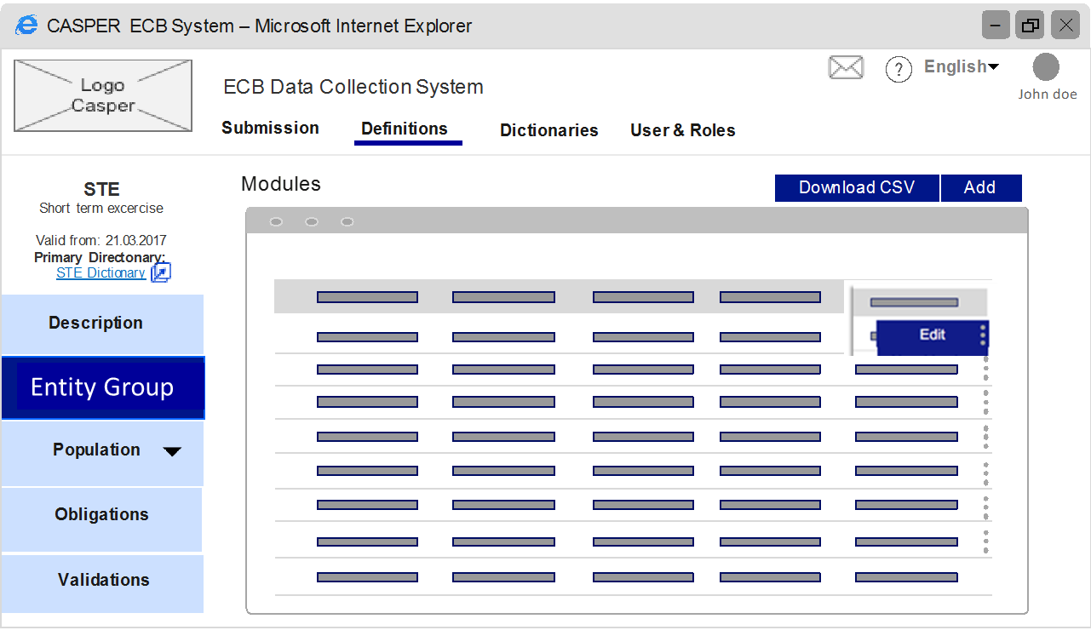
How permissions will be linked to specific CASPER role
User will be performing specific task in CASPER only if he/or she is having permissions to do so
These tasks can be controlled at 4 levels (explanation next page)
Level 1 Activity
Level 3 Activity
Level 4 Activity
Change status from A to B
Level 2 Activity

Slide 6
How permissions will be linked to specific CASPER role
These tasks can be controlled at 4 levels e.g.
Level 1 Permission
NCB user cannot define data dictionary, so in main navigation Dictionaries do not appear
Level 2 Permission
DATA Expert & Data Service expert both can see submissions related screens, but only data expert can only “trigger revalidations”.
In this case left side bar navigation will not have entry for “Trigger revalidation” for data expert (assuming this is secondary navigation item)
Level 3 Permission
Based on Level 1 & L2 permissions (optionally), screen will appear to perform specific task for user
Now screen will have various actions like Add, Edit, Delete etc. These are controlled by Level 3 permissions.
Screen is rendered according to permission at particular action button will not be visible if there is no permission to do so.
Level 4 Permission
Specific changes within the level3 action can be controlled by Level 4 permissions. Those will be in extream case. E.g. Any user can change status A to Status B, but only specific user can change status A directly to Status Z

Slide 7
How permissions & country/entity restrictions works together
Permissions mainly decides “what & how”. Further restrictions defines “For Whom”
Permissions
Controls
Individual Permissions
Data Collection
ECB User
+
Individual Permissions
Data Collection
Country
NCB/NCA User
+
+
Individual Permissions
Data Collection
Entity
External User
+
+
Legends
Mandatory
Optional

Slide 8
How permissions will be used in CASPER: Ground rules
Permissions for each UI will be implemented at micro level only
e.g. Entity group management feature will need below 5 permissions for all activities to perform
Permission code | Permission Name | Permission for
DP | Prepare Data Definitions | User can see "Definition" in main menu
DP_EG | Manage Entity Group | User can see "Manage Entity group" in sub menu
DP_EG_VIEW | View Entity Group | User can see "View entity group" screen
DP_EG_ADD | Add Entity Group | User can see "Add entity group" dialog
DP_EG_EDIT | Edit Entity Group | User can see "Edit entity group" dialog

Slide 9
How permissions will be used in CASPER: Ground rules
Granting of permissions to role can be at micro level or aggregate level
Means In “Roles to permissions assignment” screen, user administrator can assign permissions at high level or low level (to be decided by business)
If “Data expert” role gets assigned permission called “Prepare Data Definitions” then implicit all other permissions are given
Otherwise user can assign granular permissions directly.
Assigned Permissions
Received Permissions
Permission code | Permission Name
DP | Prepare Data Definitions
Permission code | Permission Name
DP | Prepare Data Definitions
DP_EG | Manage Entity Group
DP_EG_VIEW | View Entity Group
DP_EG_ADD | Add Entity Group
DP_EG_EDIT | Edit Entity Group
Assigned Permissions
Received Permissions
Permission code | Permission Name
DP_EG_VIEW | View Entity Group
Permission code | Permission Name
DP | Prepare Data Definitions
DP_EG | Manage Entity Group
DP_EG_VIEW | View Entity Group

Slide 10
Assigning permissions to Roles
INT_COLLECTION_APPROVER
INT_COLLECTION_DESIGNER
INT_COLLECTION_USER
EXT_DATA_SUBMITTER
EXT_SUBMISSION_APPROVER
INT_SUPER_USER_ADMIN
INT_USER_ADMIN
EXT_USER_ADMIN
INT_TECHNICAL_USER
EXT_TECHNICAL_USER
INT_SYSTEM_SUPPORT
Prepare Data Definition
Manage Entity Group
Add Entity Group
Edit Entity Group
Manage Entities
Add Entity
Edit Entity

Slide 11
Assigning permissions to Roles
INT_COLLECTION_APPROVER
INT_COLLECTION_DESIGNER
INT_COLLECTION_USER
EXT_DATA_SUBMITTER
EXT_SUBMISSION_APPROVER
INT_SUPER_USER_ADMIN
INT_USER_ADMIN
EXT_USER_ADMIN
INT_TECHNICAL_USER
EXT_TECHNICAL_USER
INT_SYSTEM_SUPPORT
Prepare Data Definition
Manage Entity Group
Add Entity Group
Edit Entity Group
Manage Entities
Add Entity
Edit Entity

Slide 12
Assigning permissions to Roles
INT_COLLECTION_APPROVER
INT_COLLECTION_DESIGNER
INT_COLLECTION_USER
EXT_DATA_SUBMITTER
EXT_SUBMISSION_APPROVER
INT_SUPER_USER_ADMIN
INT_USER_ADMIN
EXT_USER_ADMIN
INT_TECHNICAL_USER
EXT_TECHNICAL_USER
INT_SYSTEM_SUPPORT
Prepare Data Definition
Manage Entity Group
Add Entity Group
Edit Entity Group
Manage Entities
Add Entity
Edit Entity

Slide 13
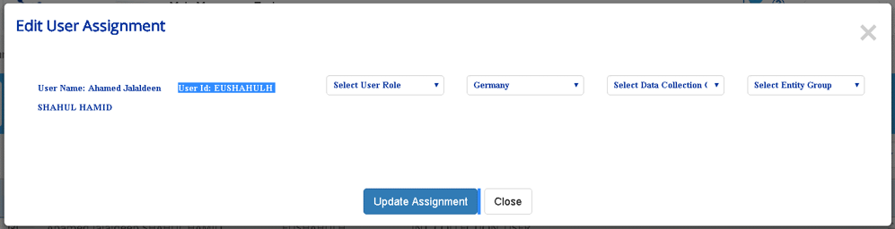
Assigning Roles to Users
Current Screen for modifications
Dropdown populated from IAM
Populated from IAM roles
Only logical to display for NCB Users as grayed entry
For others this should not be displayed
Wrong & should be removed
We need to add entities instead of entity groups. Will be part of release 2.0

Slide 14
Role of user admins
Super user admin
[Role: INT_SUPER_USER_ADMIN]
Assigns Specific Roles & Data collections to ECB Users
Assigns data collection to NCB/NCA user admins
ECB user admin
[Role: INT_USER_ADMIN]
NCB/NCA user admin
[Role: EXT_USER_ADMIN]
Assigns Specific Roles & Data collections to NCB/NCA Users

Slide 15
Assigning Roles to Users by super user admin
Role of user performing this action: INT_SUPER_USER_ADMIN
Permission required: AUTH.USER.ADDU – Add User Assignments to data collections
Add User Assignment
Userid
Role
Data Collection
EUNIMBALK
INT_USER_ADMIN
STE
Save
Cancel
This is functional representation
UX team to bring usability aspects.

Slide 16
Assigning Roles to Users by ECB user admin
Role of user performing this action: INT_USER_ADMIN
Permission required: AUTH.USER.ADDU – Add User Assignments to data collections
Add User Assignment
Userid
Role
Data Collection
EUHUBERH
INT_COLLECTION_DESIGNER
STE
Save
Cancel
This is functional representation
UX team to bring usability aspects.

Slide 17
Assigning Roles to Users by ECB user admin
Role of user performing this action: INT_USER_ADMIN
Permission required: AUTH.USER.ADDU – Add User Assignments to data collections
Add User Assignment
Userid
Country
Role
Data Collection
DEKERIM
Germany
EXT_USER_ADMIN
STE
Save
Cancel
This is functional representation
UX team to bring usability aspects.

Slide 18
Assigning Roles to Users by ECB user admin
Role of user performing this action: INT_USER_ADMIN
Permission required: AUTH.USER.ADDU – Add User Assignments to data collections
Add User Assignment
Userid
Country
Role
Data Collection
DECARSTER
Germany
EXT_DATA_SUBMITTER
STE
Save
Cancel
This is functional representation
UX team to bring usability aspects.

